Slide 1
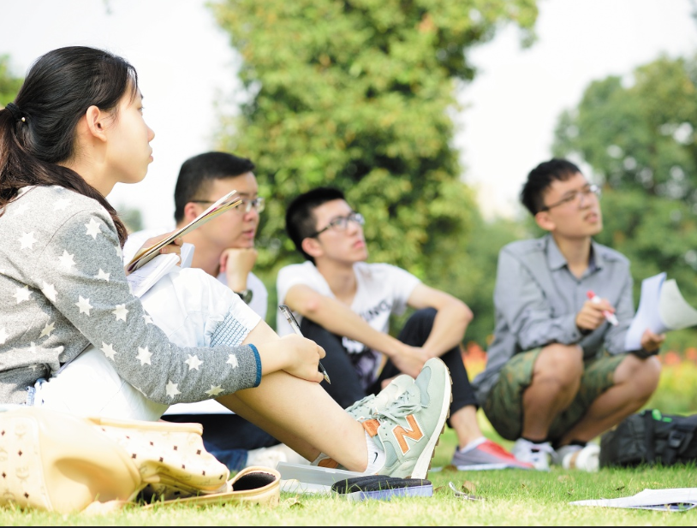

Oral Communication Skills B
(CELEN082)
Lesson 1.1

Slide 2
Lesson aims and objectives
Get to know your classmates and your tutor. Be introduced to the course aims and assessment requirements of the OCSb course. Increase awareness of the stages involved in the process of preparing and delivering an academic presentation. Practise applying strategies for choosing an appropriate topic for the presentation.

Slide 3
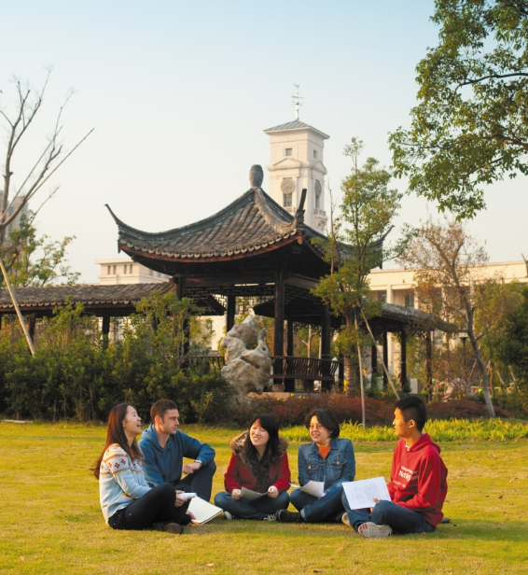
Get to know each other

Slide 4
Activity 1: My world

Slide 5
Activity 2: YOUR world

Slide 6
OCSb overview

Slide 7
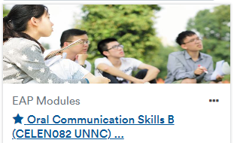



OCSb overview
Things you will need:
Moodle
Workbook
Module Handbook
Laptop/ tablet

Slide 8
OCSb overview
Moodle:
Log into Moodle and find the OCSb Moodle page.
Find the sections that contain information about the module content and the assessments.

Slide 9
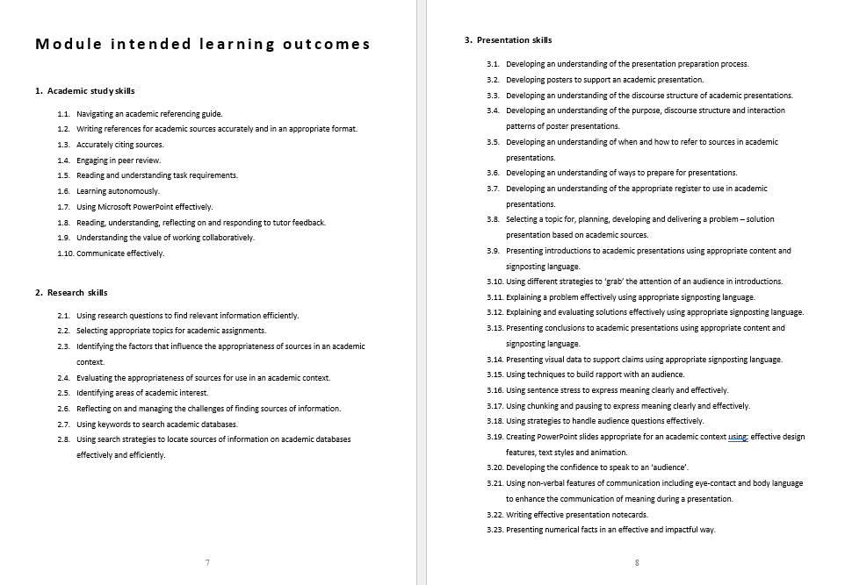
OCSb overview
Intended Learning Outcomes:
Download the OCSb Module Handbook
and find the section entitled ‘Module intended learning outcomes’.
In groups discuss the question below.
Which learning outcomes from each category do you think are the most important for you? Why?

Slide 10
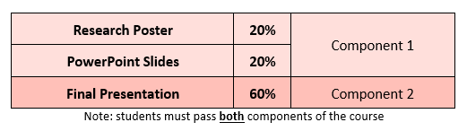
OCSb overview
Assessment overview:
For homework, read the ‘Assessment overview’ section from the OCSb Module Handbook.

Slide 11
OCSb overview
For homework, read ‘Appendix 3’ from the OCSb Module Handbook
Component 2: Final Presentation
In the end of semester exam weeks, you will give an individual presentation of 8-11 minutes.
You must choose a topic related to your major (check your topic with your OCSb tutor).
The type of presentation is problem/ solution/ evaluation. In your presentation, you must:
clearly explain what the problem is and why it is a problem.
provide two solutions which could solve or reduce the problem.
evaluate the effectiveness of the solutions.
You must use sources to support the content of the presentation.

Slide 12
OCSb overview
For homework, read ‘Appendix 1’ from the OCSb Module Handbook
Component 1 (Part 1): Research Poster
In Lesson 5.1, you will take part in a Research Poster event.
Before the event, you will use a template to create a poster consisting of images of and information from three academic sources related to your chosen Final Presentation topic.
At the event, you will display your poster on the wall. You will stand next to it and answer questions about it.
You will receive a grade based on the information you have included in the poster.

Slide 13
OCSb overview
For homework, read ‘Appendix 2’ from the OCSb Module Handbook
Component 1 (Part 2): PowerPoint Slides
You will create a PPT for your Final Presentation and submit it to Moodle in Week 8.
You will receive a mark based on aspects of content and design.
Your OCSb tutor will give you feedback in preparation for the Final Presentation.

Slide 14
OCSb overview
Key dates:
Week 1 | Choose a potential topic for your Final Presentation
Week 5 | Research Poster event
Week 8 | Submit your PowerPoint Slides to Moodle
Week 9 | Live Lecture on Friday
Before Lesson 10.1 | Receive feedback on your PowerPoint Slides
Week 11-12 | Final Presentation (practice sessions)
CELE Exam Weeks | Final Presentation (assessed)
For homework, read the section ‘Module overview’ from the OCSb Module Handbook

Slide 15
The process of preparing
and delivering
an academic presentation

Slide 16

Presentation stages
Sort the stages of preparing and delivering an academic presentation into a logical order.
Choose an appropriate topic.
Develop the content of your presentation.
Deliver your presentation to your audience.
Practise your presentation.
Collect information about your topic.
Understand the purpose and audience of the presentation.
Create your visual aids (e.g. PPT slides).

Slide 17
Presentation stages
Understand the purpose and audience of the presentation.
You will have to:
develop a research strategy.
find appropriate sources.
take notes.
Choose an appropriate topic.
Collect information about your topic.
There may be some overlap here. Many people use the process of creating visual aids as a way of developing the content of their presentation.
Develop the content of your presentation.
Create your visual aids (e.g. PPT slides).
Practise your presentation.
You will do a practice presentation in Week 11 or 12 and get feedback from your tutor.
Deliver your presentation to your audience.

Slide 18
Choosing an
appropriate topic

Slide 19
Choosing topics at university
The ability to choose an appropriate topic is an important skill at university. During your academic career, you may have several opportunities to do this.
For example:
In Year 4, you may need to or have the opportunity to complete a dissertation (a long piece of writing based on independent research).
If you wish to pursue postgraduate study, you will likely have to complete a dissertation or thesis.

Slide 20
Choosing a topic: Considerations
When choosing the topic for your OCSb Final Presentation, please remember the following points:
Your presentation topic must be related to your major (i.e. a problem relevant to your major AND / OR solutions relevant to your major that are used to address a problem).
Your topic must be specific enough that you can cover it fully in 8-11 minutes.
You must be able to find sources about your topic that are written in English.
Your presentation title must identify a problem and indicate that your purpose is to present solutions for it.

Slide 21
Choosing a topic: Methods
In your group, complete the tasks below:
List two methods that you could use to look for a topic for your OCSb presentation.
For each of these methods, identify at least one advantage and one disadvantage.

Slide 22
Choosing a topic: Brainstorming topics
In your group, make a list of at least five general topics related to your major.
Hint: Think about what you studied in Semester 1.
For example:
International Business: Marketing
Engineering: Aircraft design
Computer Science: Machine Learning
One member of your group should write down your topics.
Which topic are you most interested in? Tell your group and explain why.

Slide 23

Choosing a topic: Using textbooks
Once you've chosen a general area of interest, textbooks can help you identify a more specific 'problem'. Textbooks are written for people studying a subject and, therefore, often provide an overview of this subject.

Slide 24

Choosing a topic: Using textbooks
Imagine you are an International Communications student. You are interested in the general topic of ‘smartphones’.
Look at the contents page of a book titled ‘Smartphone Cultures’ and identify at least 2 specific problems you could focus on.
Contents Part 1: Introduction Introducing smartphone cultures. Part 2: Family Consumption Parental practices in the era of smartphones. Older people, smartphones and digital illiteracy. Part 3: Smartphones and Education Smartphones in the classroom. | 1 30 66 101 | Addiction or freedom? Teenagers’ attachment to smartphones. Part 4: Smartphones in Society Smartphones and communication etiquette. Smartphones and cultural diversity. Smartphones in agricultural societies. Part 5: Conclusion Conclusion and Further Research. | 168 207 263 308 366
Adapted from: Vincent, J. and Haddon, L. (eds.) (2018) Smartphone Cultures. Abingdon: Routledge.

Slide 25
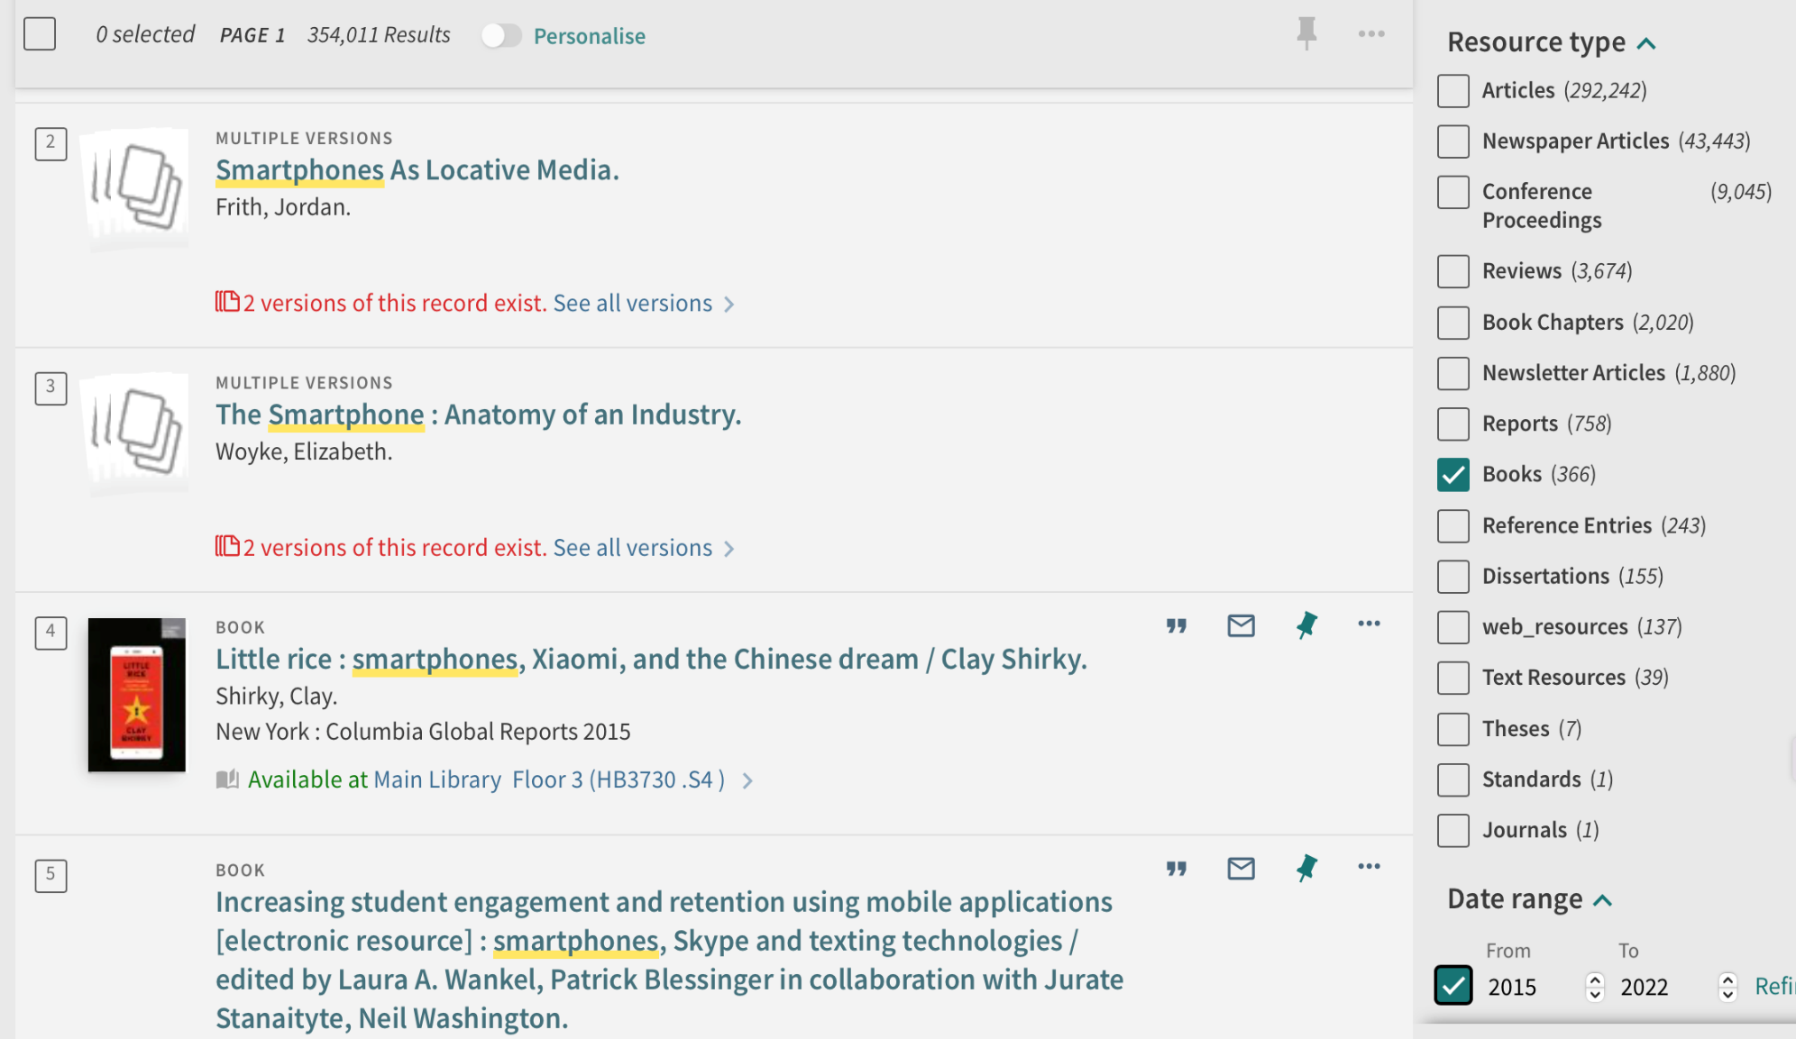
Choosing a topic: Finding books on NUsearch
Use NUsearch to search for books on the topics from the list you generated earlier.
Use the ‘Resource Type’ filter to limit your search to books.
Use the ‘Date Range’ filter to search for up-to-date books.

Slide 26

Choosing a topic: Using the news
Another strategy for identifying a specific problem is to increase your awareness of current events. This can be done by:
Reading a newspaper, or subject specific periodical.
OR
Conducting an internet search using the ‘news’ filter.

Slide 27
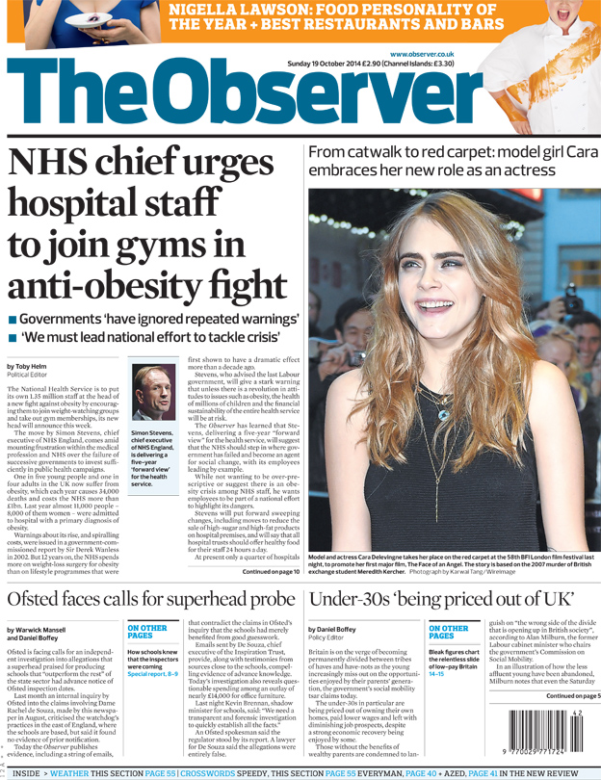
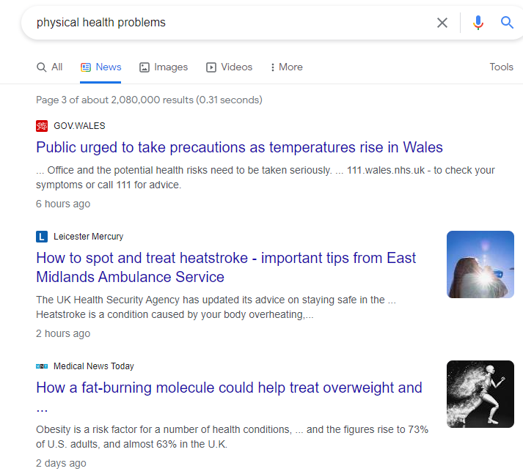
Choosing a topic: Using the news
Imagine you are a Biology student. Look at the newspaper front page and the Google search results and identify the specific problem that they both highlight.

Slide 28
Writing a presentation title
Analyse four presentation titles and decide whether they are EFFECTIVE or NOT EFFECTIVE based on the three questions below.
Is the topic specific enough? Can the student cover the topic fully in 8-11 minutes?
Will the student be able to find sources about this topic that are written in English?
Does the presentation title identify a problem and indicate that the student will present solutions for it?
How to tackle the issue of obesity
The problem of obesity in the UK
Addressing rising obesity levels in Ningbo
Measures to alleviate back pain in the UK
If a title is not effective, consider how you could improve it.

Slide 29
Writing a presentation title
NOT EFFECTIVE! The causes of obesity may vary in different places or age groups. Narrow the topic down more.
How to Tackle the Issue of Obesity
The Problem of Obesity in the UK
Addressing Rising Obesity Levels in Ningbo
Measures to Alleviate Back Pain in the UK
How to Tackle the Issue of Obesity in the UK
How to Tackle the Issue of Obesity amongst children in the UK
NOT EFFECTIVE! The title does not indicate this is a PROBLEM / SOLUTION presentation.
Measures to Address the Issue of Obesity in the UK
EFFECTIVE! But it might be difficult to find sources written in English.
Addressing Rising Obesity Levels in China
NOT EFFECTIVE! The measures used to alleviate back pain may depend on the age and/or background of the people at risk rather than the country. Adjust the focus.
Measures to Alleviate Back Pain amongst Athletes

Slide 30
Writing a presentation title: STEM
Analyse three presentation titles and decide whether they are EFFECTIVE or NOT EFFECTIVE based on the three questions below.
Is the topic specific enough? Can the student cover the topic fully in 8-11 minutes?
Will the student be able to find sources about this topic that are written in English?
Does the presentation title identify a problem and indicate that the student will present solutions for it?
How to use mathematics to address environmental issues.
Measures to improve mobile devices.
How to improve computer security.
If a title is not effective, consider how you could improve it.

Slide 31
How to use mathematics to address environmental issues.
NOT EFFECTIVE! There are many different ‘environmental issues’. It would be difficult to ‘address’ them all in 8-11 minutes. The student could focus on one specific issue.
How to use mathematics to address biodiversity loss.
How to use mathematics to reduce CO₂ emissions.
Still NOT EFFECTIVE! The student may wish to narrow down the topic even further, to focus on a more specific ‘area’ (if they can find enough sources in English). This might make it easier for them to explain the problem.
How to use mathematics to address biodiversity loss in the Amazon rainforest.
How to use mathematics to reduce CO₂ emissions from coal-fired power stations.

Slide 32
Measures to improve mobile devices
NOT EFFECTIVE! There are many different types of ‘mobile devices’. It would be difficult to ‘improve’ them all in 8-11 minutes. The student could focus on one specific type.
Measures to improve smartphones
Measures to improve the iPhone
Still NOT EFFECTIVE! These devices can be ‘improved’ in many ways. It would be difficult to discuss them all in 8-11 minutes. The student could focus on one specific aspect of these technologies.
Measures to improve the battery life of smartphones
Measures to improve the durability of the iPhone screen

Slide 33
How to improve computer security.
NOT EFFECTIVE! Computer security can be ‘improved’ in many ways. It would be difficult to discuss them all in 8-11 minutes. The student could focus on one particular threat.
How to protect computers from ransomware.
How to protect computer systems from phishing attacks.
Still NOT EFFECTIVE! The student may wish to narrow this down to focus on the particular person or group who will be doing the ‘protecting’. This will likely influence the potential solutions available to them.
How governments can protect their computer systems from phishing attacks.
How companies can protect their computer systems from phishing attacks.

Slide 34
Choosing a presentation topic: Independent practice
By applying the strategies that you have practised using in this lesson, you should now:
Start to think of possible appropriate topics for your OCSb presentation.
Practise writing titles for those topics.
Language for presentation titles
How to + verb: How to tackle the issue of obesity in the UK
Measures to + verb: Measures to alleviate back pain amongst athletes
verb-ING: Addressing rising obesity levels in China

Slide 35
Homework
Due | Task
Before Thursday 20th February, 9am | Post possible presentation titles on your OCSb group’s Class Team.
Lesson 1.2 | Download the OCSa Module Handbook and familiarise yourself with the following sections: Module Intended Learning Outcomes Module overview Assessment overview Appendix 1: Research Poster Information Appendix 2: PowerPoint Slides Information Appendix 3: Final Presentation Information Watch the video 'How to use Google to identify possible presentation topics‘ in the Week 1 section.

